Slide 1
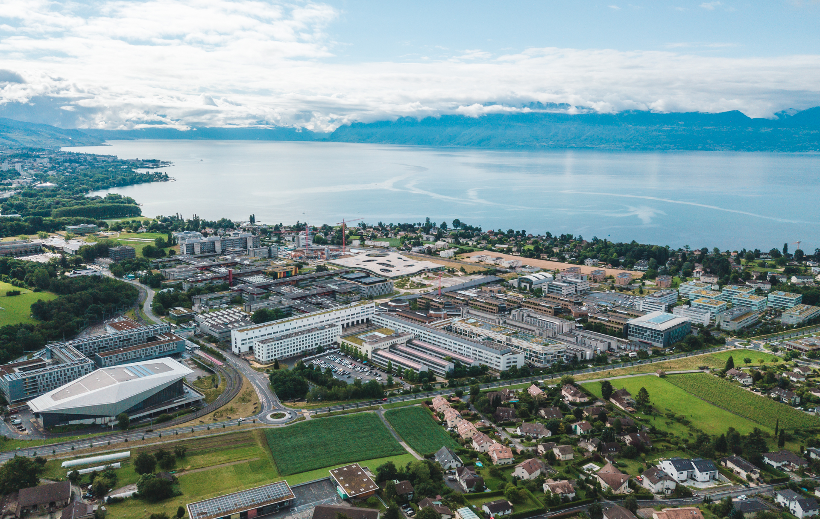
Part 4
MILP optimization of Energy Systems and Scenario Analysis
Sai Ravi, Michele Poli
2025

Slide 2
Project Structure
Boiler | Geothermal cogeneration system
Two 1-stage heat pumps | Cogeneration engine
2-stage heat pump | Solid oxide fuel cell (SOFC)
Photovoltaic panels | Your ideas
Model + Buildings
HP + Heat Recovery
Energy Technologies
.dat
.mod
.dat
.dat
…
.mod
.mod
.mod
.mod
.run

Slide 3
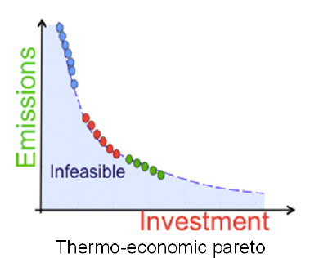
Overview
Adapt your current model of EPFL energy systems with the results obtained from the previous parts
(Part 1: heating clusters and buildings characteristics, Part 2: Heat recovery scenarios, Part 3: Heat pump model)
Suggest at least three different new energy systems (different scenarios → different objective function)
  EPFL has very little money to invest at present and wants to minimize the costs of installing new technologies.
  Due to the financial crisis, EPFL expects to have much less money in the coming years and wants to minimize the operating costs.
  EPFL wants to become a greener university and wants to minimize the total equivalent carbon emissions.
Conduct a multi-objective (Pareto) optimization: analyzing the trade-off between different objectives
Assess the sensitivity of your solutions to variations: natural gas and electricity prices, carbon tax..

Slide 4
Structure of the sets
Buildings
Building 1
LowTemp Buildings
MediumTemp Buildings
Building 2
HeatingLevel
Building 3
Low T
Building …
Medium T
Building 24

Slide 5
Utilities Set
ElecGridBuy
ElecGridSell
NatGasGrid
Technologies
Resources
Boiler
Utilities
Technologies: List of ETs
Grids: units to buy resources
Utilities: Technologies + Grids
1. Binary Variables (use, use_t)
var use{Utilities} binary;
var use_t{Utilities, Time} binary;
2. Continuous variables (mult, mult_t)
var mult{Utilities} >= 0
var mult_t{Utilities, Time} >= 0
HP
Fuel Cell
PV
…

Slide 6
Layers and other sets
ElecGridBuy
ElecGridSell
NatGasGrid
Boiler
NatGas
Heating
ElectricitySup
HP
Electricity
UtilitiesType
Layer
ElectricityCon
Fuel Cell
UtilitiesType:
  Type of technology
  List of ET sub-sets
Layer:
  Type of consumed/produced resource
  List of ET sub-sets
PV
…

Slide 7
Overall structure of the sets
ElecGridBuy
ElecGridSell
NatGasGrid
Building 1
Boiler
NatGas
Heating
Building 2
ElectricitySup
HP
Electricity
Building 3
ElectricityCon
Fuel Cell
PV
Building …
Low T
…
Building 24
Medium T

Slide 8
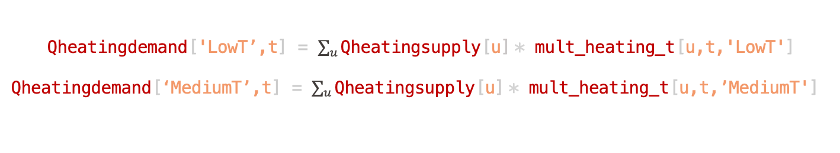
Constraints: heating balances
Decision variable for operation
In the model
Qheatingdemand['LowT’,t] = $\sum_{u}{\text{Qheatingsupply}\text{[}\text{u}\text{]}}$* mult_heating_t[u,t,'LowT']
Qheatingdemand[‘MediumT’,t] = $\sum_{u}{\text{Qheatingsupply}\text{[}\text{u}\text{]}}$* mult_heating_t[u,t,’MediumT']
Qheatingsupply ['HP2stage']
cinv1['HP2stage']
HP
Your task
Flowin['Electricity','HP2stage'] = Qheatingsupply ['HP2stage'] / COP
cinv2['HP2stage']

Slide 9
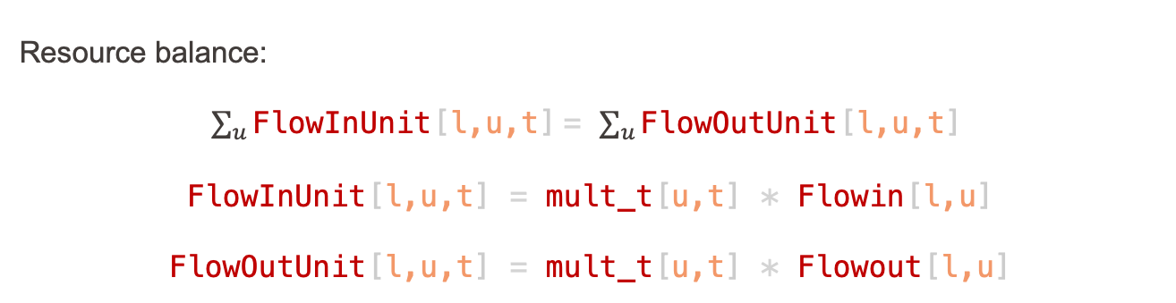
Constraints: resource balance
Resource balance:
$\sum_{u}{\text{FlowInUnit}\text{[}\text{l}\text{,}\text{u}\text{,}\text{t}\text{]}}$= $\sum_{u}{\text{Flow}\text{Out}\text{Unit}\text{[}\text{l}\text{,}\text{u}\text{,}\text{t}\text{]}}$
FlowInUnit[l,u,t] = mult_t[u,t] * Flowin[l,u]
FlowOutUnit[l,u,t] = mult_t[u,t] * Flowout[l,u]
Qheatingsupply ['HP2stage']
cinv1['HP2stage']
HP
Your task
Flowin['Electricity','HP2stage'] = Qheatingsupply ['HP2stage'] / COP
cinv2['HP2stage']
reference size

Slide 10
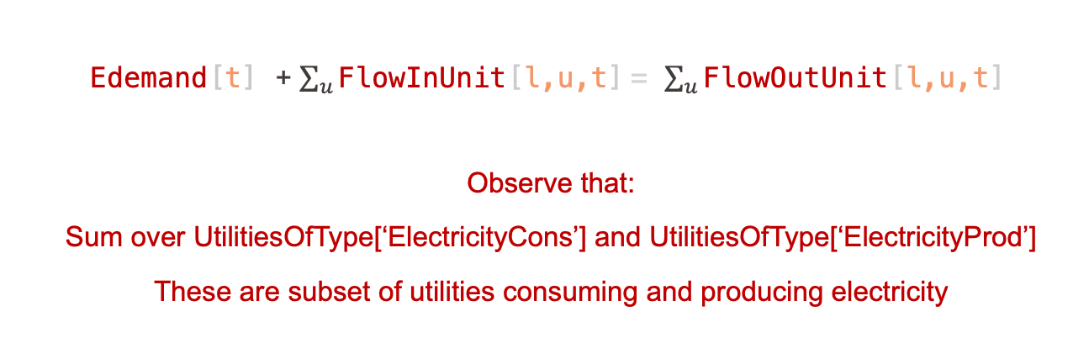
Constraints: electricity balance
Edemand[t] + $\sum_{u}{\text{FlowInUnit}\text{[}\text{l}\text{,}\text{u}\text{,}\text{t}\text{]}}$= $\sum_{u}{\text{Flow}\text{Out}\text{Unit}\text{[}\text{l}\text{,}\text{u}\text{,}\text{t}\text{]}}$
Observe that:
Sum over UtilitiesOfType[‘ElectricityCons’] and UtilitiesOfType[‘ElectricityProd’]
These are subset of utilities consuming and producing electricity

Slide 11
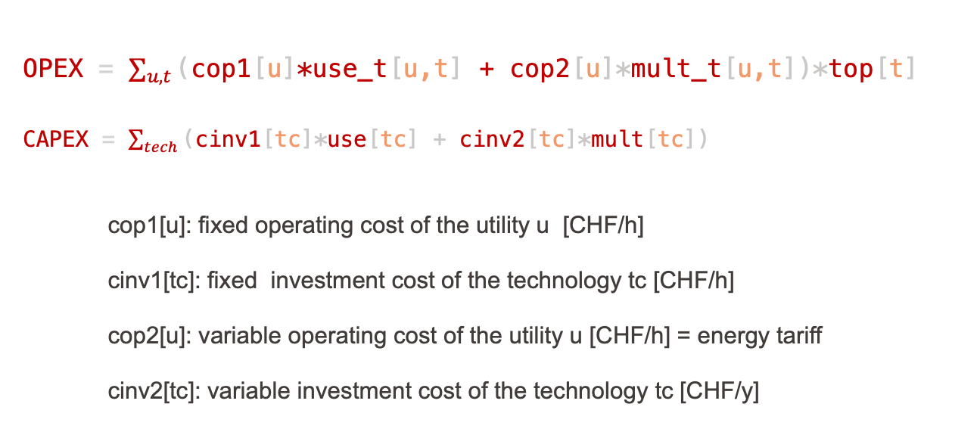
Objective function: TOTEX
OPEX = $\sum_{u,t}{\text{(}\text{cop}\text{1[}\text{u}\text{]}\text{∗}\text{use}\text{_}\text{t}\text{[}\text{u}\text{,}\text{t}\text{]} \text{+ }\text{cop}\text{2[}\text{u}\text{]∗}\text{mult}\text{_}\text{t}\text{[}\text{u}\text{,}\text{t}\text{])∗}\text{top}\text{[}\text{t}\text{]}}$
CAPEX = $\sum_{tech}{\text{(}\text{cinv}\text{1[}\text{tc}\text{]∗}\text{use}\text{[}\text{tc}\text{] + }\text{cinv}\text{2[}\text{tc}\text{]∗}\text{mult}\text{[}\text{tc}\text{])}}$
cop1[u]: fixed operating cost of the utility u [CHF/h]
cinv1[tc]: fixed investment cost of the technology tc [CHF/h]
cop2[u]: variable operating cost of the utility u [CHF/h] = energy tariff
cinv2[tc]: variable investment cost of the technology tc [CHF/y]
You can easily change the energy tariffs in moes.dat: c_spec

Slide 12
Your TODOs
Read part 4 of Project description.pdf
Check that your ampl files is running with PVs and boilers
Add your typical days
Include your best heat recovery option as a new unit (the model should be linear)
Add heatpumps using the COP from Part 3
Add other types of units you would like to integrate and new layers if needed (biogas, biomass, H2, …)
Run scenarios, sensitivity analysis on energy tariffs, pareto fronts

